Slide 1
Azure Kubernetes Service (AKS) Storage
WorkshopPlus – Kubernetes Tech Briefing

Slide 2
Conditions and terms of use
© Microsoft Corporation. All rights reserved.
You may use these training materials solely for your personal internal reference and non-commercial purposes. You may not distribute, transmit, resell or otherwise make these training materials available to any other person or party without express permission from Microsoft Corporation. URL’s or other internet website references in the training materials may change without notice. Unless otherwise noted, any companies, organizations, domain names, e-mail addresses, people, places and events depicted in the training materials are for illustration only and are fictitious. No real association is intended or inferred. THESE TRAINING MATERIALS ARE PROVIDED “AS IS”; MICROSOFT MAKES NO WARRANTIES, EXPRESS OR IMPLIED IN THESE TRAINING MATERIALS¹

Slide 3

Learning Units covered in this Module
 | Core Kubernetes Storage Concepts
 | Storage options running Kubernetes on Azure

Slide 4
Core Kubernetes Storage Concepts

Slide 5
Objectives
After completing this Learning, you will be able to:
Understand….
How Kubernetes abstracts or hides underlying disk storage implementations from applications running inside Pods.
How to create disk storage that can be attached to Pods so applications running inside containers can read/write data.
The storage options that are available in Azure, how these work and how to manage them.
The recommended practices & guidance for application data storage as defined by official Microsoft architecture documentation.

Slide 6




Storage Concepts
Ephemeral Volume
Persistent Volume
Application data could be stored directly inside a container, but this is a bad practice.
Pods are ephemeral. The containers inside them are destroyed (and all data lost) when the Pod is deleted or rescheduled.
Storage is the process of saving data outside of the container so that it can survive beyond the lifetime of a single pod.
Kubernetes excels at abstracting or hiding the true location of the saved data from the application running inside the Pod. This allows separation of application & data.
A volume or persistent volume represents a way to store, retrieve, and persist data across pods and through the application lifecycle.
Persistent Volume Claim
Storage Class
Persistent Volume Claim represents an applications desire for storage, whilst Storage Class defines different types of underlying storage available.
Notes:
READ MORE: https://learn.microsoft.com/en-us/azure/aks/concepts-storage
This module will concentrate on those storage options which are available when running Kubernetes on Azure.

Slide 7
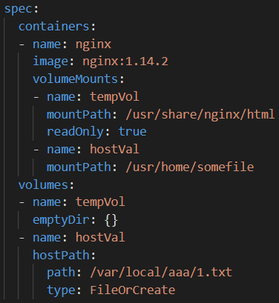
Ephemeral Volumes
Ephemeral volume types have a lifetime of a pod. Ephemeral volumes include:
Empty Dir – A temporary folder for all containers within a Pod to read/write to.
  Host Path – Mounts a file or directory from the host node's filesystem into your Pod. Not practical in a multi-node cluster.
  Config Map/Secret – A Read-only folder that provides a way to inject configuration data into pods.

Slide 8
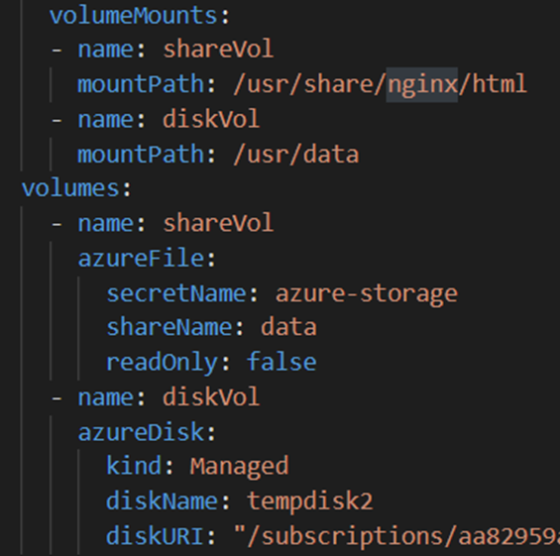
Persistent Volumes
Persistent volumes exist beyond the lifetime of a pod. Persistent volumes include:
  Azure Disk – Mounts an Azure Data Disk into a pod.
  Azure File – Mounts an Azure File Share (SMB 2.1/3.0) to a Pod.
  Persistent Volume Claim - A way for users to "claim" durable storage without knowing the details of the cloud environment.
Notes:
Check out the azure aks disk types
Azure Disks
The default storage class provisions a standard SSD Azure disk.Standard storage is backed by Standard SSDs and delivers cost-effective storage while still delivering reliable performance.The managed-csi-premium storage class provisions a premium Azure disk.Premium disks are backed by SSD-based high-performance, low-latency disk. Perfect for VMs running production workload. If the AKS nodes in your cluster use premium storage, select the managed-premium class.
Azure File:
Standard_LRS - standard locally redundant storage (LRS)Standard_GRS - standard geo-redundant storage (GRS)Standard_ZRS - standard zone redundant storage (ZRS)Standard_RAGRS - standard read-access geo-redundant storage (RA-GRS)Premium_LRS - premium locally redundant storage (LRS)Premium_ZRS - premium zone redundant storage (ZRS)

Slide 9
Persistent Volumes
A PersistentVolume (PV) resource is a piece of storage in the cluster that has been provisioned by an administrator or dynamically provisioned using Storage Classes.
PVs are volume plugins like Volumes but have a lifecycle independent of any individual Pod that uses the PV.
It is a cluster wide resource (not namespaced), available to for any user to claim.
There are two ways PVs may be provisioned:
  Statically - A cluster administrator creates multiple PVs that carry the details of the real storage, which is available for use by cluster users.
  Dynamically - When none of the available static PVs match a user's Persistent Volume Claim, the cluster will try to dynamically provision a volume specially for the PVC, based on a specified Storage Classes.

Slide 10
Persistent Volume Claim
A PersistentVolumeClaim (PVC) is an object which a Pod must reference when it wants to use storage.
A PVC always points to a PV.
If a Pod references a PVC, it is in-directly also referencing the PV.
Depending on the access mode, a PVC can be connected to many different nodes/pods at the same time. This way storage is shared across Pods.
Deleting a Pod does not affect the PVC or PV.
  Deleting a PVC will usually delete the PV and dynamically created storage.
  Exact behavior depends on the Storage Class.

Slide 11
Storage Class
Administrators like to create the underlying storage disks automatically.
Dynamic storage creation is also possible.
A StorageClass (SC) defines how a Persistent Volume (PV) is dynamically provisioned.
Acts as a blueprint for storage, specifying the type of storage, performance characteristics, and reclaim policies.
Cluster Admins deploy SCs to limit the size and types of storage which can be dynamically requested and created by Application Admins.

Slide 12








Abstracting external storage using Volumes
Kubernetes offers many flexible options for mounting volumes into Pods.
Cluster
Namespace
Azure Disk
Node
Pod
Azure
BLOB Store
Volumes
Host Path
Containers
Azure
File Share
Empty Dir
Example external storage options

Slide 13
Basic Storage Options

Slide 14

Ephemeral OS disks
OS Disks for all Azure VMs have hot copies on backend storage. Allows for recovery in the event of a failure.
Not necessary in an AKS cluster as no data is stored locally.
Eliminating the backup copy increases Read/Write performance and decreases overall VM cost.
Ephemeral OS disks are stored only on the host physical machine.
Lower read/write latency, together with faster node scaling and cluster upgrades.
OS Ephemeral OS disks are the default (when possible).
Notes:
https://learn.microsoft.com/en-us/azure/aks/concepts-storage
The OS disk (c:\) for all Azure VMs is located on a physical server with a backup held in backend storage.
This allows the VM to be recovered from the backend copy should the physical machine fail.
Whilst this is desirable for many VMs, it doesn’t make sense for Kubernetes nodes as these are all identical with workloads deployed by K8s itself.
The presence of a constantly updated backup copy can lead to Read/Write performance on the VM.
Whilst minimal, this is measurable.
Eliminating the backup copy increases Read/Write performance and decreases overall VM cost.
Ephemeral OS disks are stored only on the host machine, just like a temporary disk.
Leads to lower read/write latency, together with faster node scaling and cluster upgrades.
When you don't explicitly request Azure managed disks for the OS, AKS defaults to ephemeral OS if possible, for a given node pool configuration.
https://learn.microsoft.com/en-us/azure/aks/concepts-storage#ephemeral-os-disk

Slide 15
Disks, Files, Blobs, Storage Pools
Persistent Volumes (PVs) in Kubernetes are resources backed by real physical storage.
PVs can be created manually by an admin or Kubernetes can automatically create them.
  Once available, PVs can be connected to Pods.
On Azure there are 4 storage types typically used by AKS: Azure Disk, Azure Files, Azure NetApp Files, or Azure Blobs.
A relatively new service called Azure Storage is replacing the direct use of the 4 standard types.
  Acts as an intermediatory between K8s and the underlying physical storage.
  Allows for quicker provisioning of storage for new deployments and Pods.
Notes:
https://learn.microsoft.com/en-us/azure/aks/concepts-storage#volumes

Slide 16
Legacy Storage Drivers
Support for the 4 external storage types is via use of a Kubernetes Driver.
  Many add-on drivers exist out of the box for connecting to different storage types.
  Originally only the Microsoft created drivers for Azure Disks & Azure Files where available.
Different driver types are referenced via the various StorageClasses in K8s.
Depending on the VM SKU being used, the driver might have a per-node volume limit,
  e.g. a 16-core node is limited to 64 attached volumes.
Notes:
https://learn.microsoft.com/en-us/azure/aks/concepts-storage#volumes

Slide 17

Modern CSI Drivers
Container Storage Interface (CSI) drivers are the modern replacement for exposing arbitrary block and file storage systems to containerized workloads on Kubernetes
    https://github.com/kubernetes-sigs/azuredisk-csi-driver
    https://github.com/kubernetes-sigs/azurefile-csi-driver
    https://github.com/kubernetes-sigs/blob-csi-driver
    https://github.com/kubernetes-sigs/azurelustre-csi-driver
      Lustre will be covered later
CSI drivers AND legacy drivers are enabled on new clusters by default.
On a new AKS cluster, several CSI storage classes are enabled by default:
  managed-csi – Standard Azure Disk (HDD or Standard SSD) for general-purpose workloads.
  managed-csi-premium – Premium SSD-backed Azure Disk for high-performance workloads.
  azurefile-csi – Azure Files with SMB/NFS support for shared file systems.
  azurefile-csi-premium – Premium Azure Files for workloads requiring higher throughput and performance
Notes:
https://learn.microsoft.com/en-us/azure/aks/concepts-storage#volumes
Enable CSI drivers on an existing cluster.
https://learn.microsoft.com/en-us/azure/aks/csi-storage-drivers#enable-csi-storage-drivers-on-an-existing-cluster

Slide 18
Azure Disk
Use Azure Disk to create a Kubernetes DataDisk resource. Disks types include:
  Premium SSDs (recommended for most workloads)
  Ultra disks
  Standard SSDs
  Standard HDDs
Because an Azure Disk is mounted as “ReadWriteOnce”, it's only available to a single node
This example uses the “old” azureDisk driver, not the newer CSI.
Notes:
https://learn.microsoft.com/en-us/azure/aks/concepts-storage#azure-disk
https://learn.microsoft.com/en-us/azure/aks/azure-disk-csi
The default storage class provisions a standard SSD Azure disk.Standard storage is backed by Standard SSDs and delivers cost-effective storage while still delivering reliable performance.The managed-csi-premium storage class provisions a premium Azure disk.Premium disks are backed by SSD-based high-performance, low-latency disk. Perfect for VMs running production workload. If the AKS nodes in your cluster use premium storage, select the managed-premium class.

Slide 19
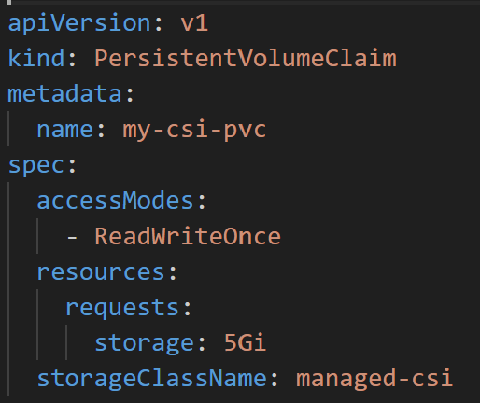
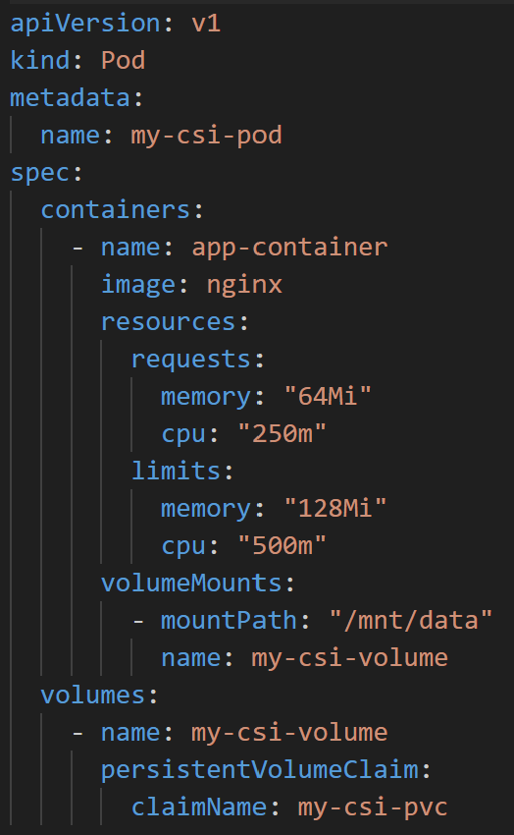
Azure Disk – CSI Driver Example
Here a CSI driver in the managed-csi storage class is used to automatically create a 5Gb standard Azure Disk.

Slide 20
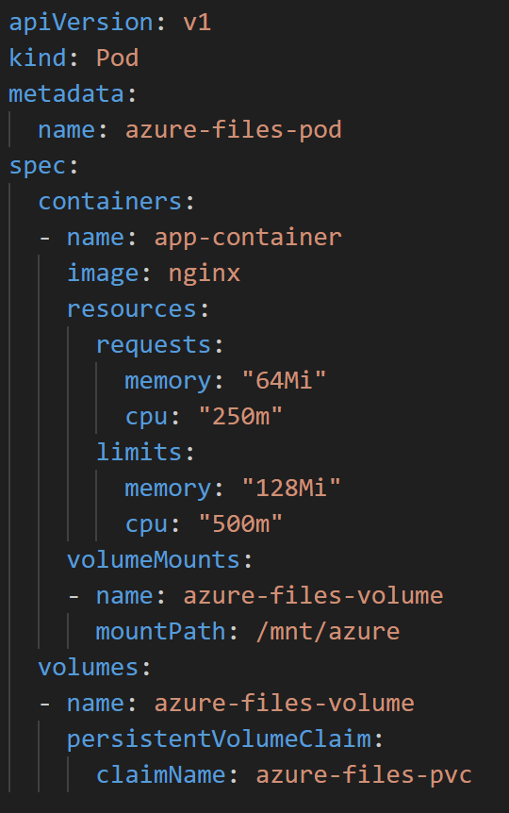
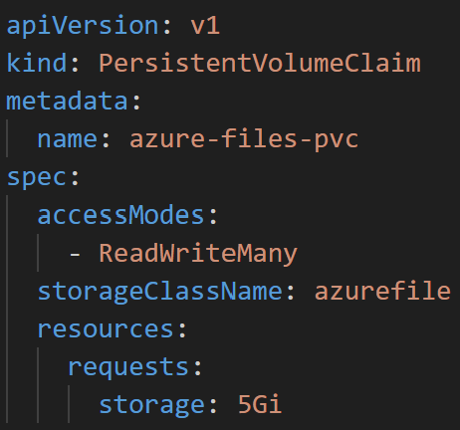
Azure Files (aka Azure SMB File Shares)
Use Azure Files to mount a:
  Server Message Block (SMB) version 3.1.1 share
  Network File System (NFS) version 4.1 share.
Azure Files let you share data across multiple nodes and pods and can use:
Azure Premium storage backed by
  High-performance SSDs
  Regular HDDs
This example uses the legacy azurefile driver.
Notes:
https://learn.microsoft.com/en-us/azure/aks/concepts-storage#azure-disk
https://learn.microsoft.com/en-us/azure/aks/azure-files-csi
Standard_LRS - standard locally redundant storage (LRS)Standard_GRS - standard geo-redundant storage (GRS)Standard_ZRS - standard zone redundant storage (ZRS)Standard_RAGRS - standard read-access geo-redundant storage (RA-GRS)Premium_LRS - premium locally redundant storage (LRS)Premium_ZRS - premium zone redundant storage (ZRS)

Slide 21
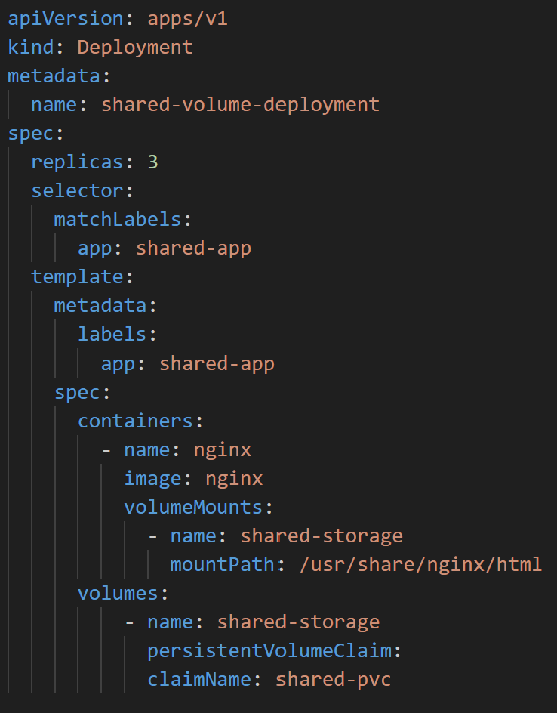
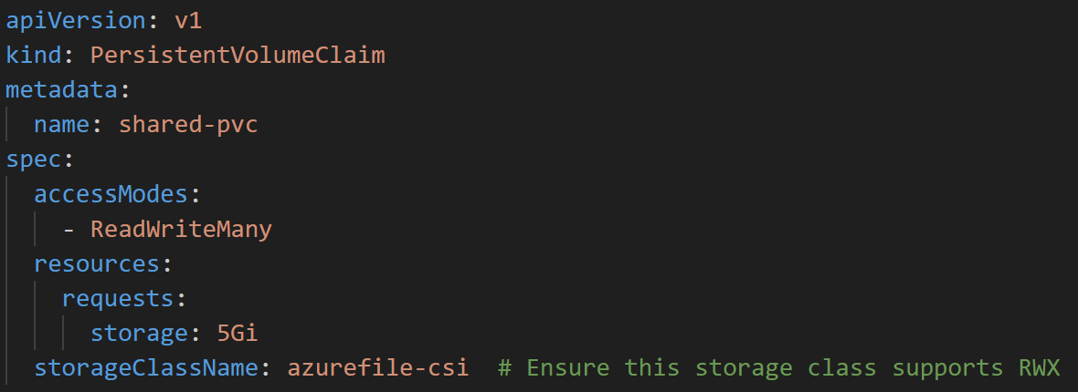
Azure Files – CSI Driver Example
Here the azurefiles-csi storage class is used.
This creates an Azure File share (on a storage account) which can be mounted to several Pods at the same time.
Notes:
https://learn.microsoft.com/en-us/azure/aks/concepts-storage#azure-disk

Slide 22
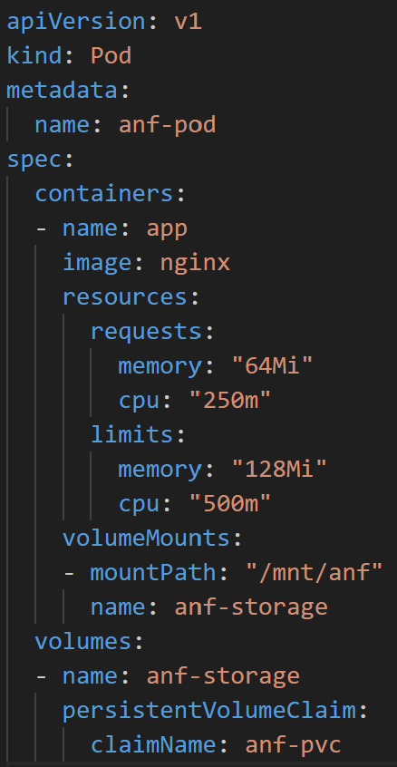
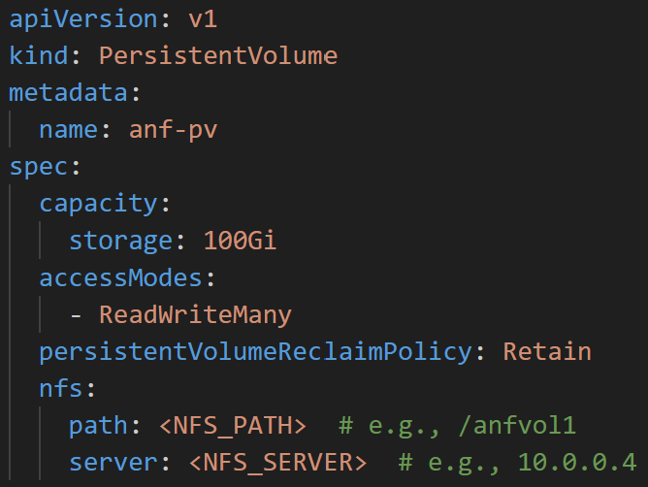
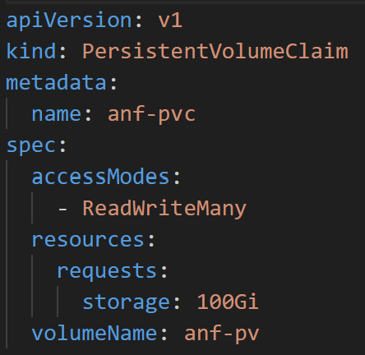
Azure NetApp Files
Azure NetApp Files is a managed service for the building of Network-Attached-Storage (NAS) in Azure.
Used to create either SMB or NFS shares.
Underlying disks can be:
  Ultra Storage
  Premium Storage
  Standard Storage
Uses the native k8s nfs driver.
Notes:
https://learn.microsoft.com/en-us/azure/aks/concepts-storage#azure-disk
https://learn.microsoft.com/en-us/azure/azure-netapp-files/azure-netapp-files-introduction

Slide 23
Azure Blob Storage
Use Azure Blob Storage when you want to expose data via:
  NFS v3.0
  BlobFuse
BlobFuse is a virtual file system driver for Azure Blob Storage.
  Use for accessing existing Azure block blob data through the Linux file system.
  Page blobs are not supported.
Two Microsoft defined storage classes exist but must be enabled using --enable-blob-driver.
Notes:
https://learn.microsoft.com/en-us/azure/aks/concepts-storage#azure-disk
https://learn.microsoft.com/en-us/azure/storage/blobs/blobfuse2-what-is
https://learn.microsoft.com/en-us/azure/aks/azure-blob-csi?tabs=NFS

Slide 24
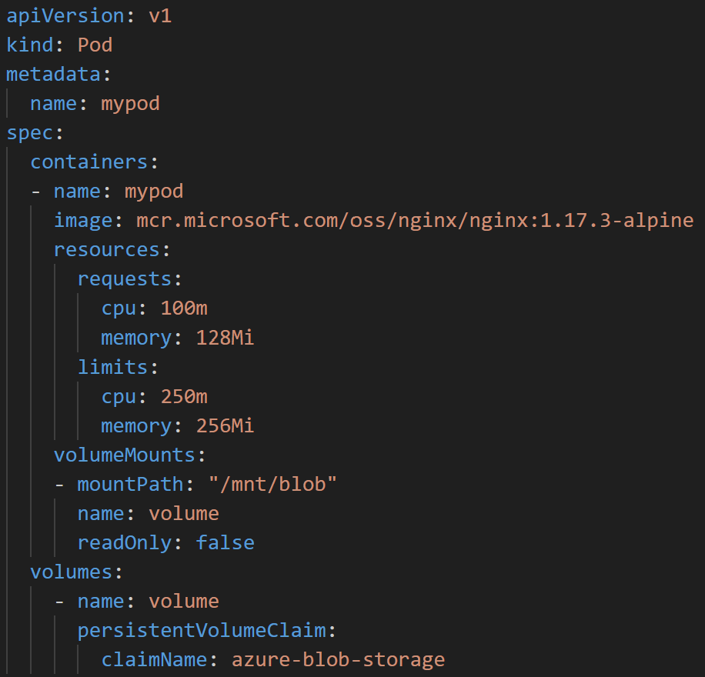
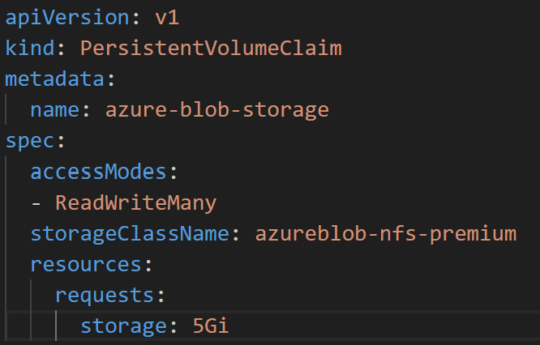
Azure Blob Storage Example
This example creates an NFS share on premium SSD disks and mounts into a Pod.
Notes:
https://learn.microsoft.com/en-us/azure/aks/azure-csi-blob-storage-provision?tabs=mount-nfs%2Csecret

Slide 25
Azure NetApp Files or Azure Files?
Azure Net Apps Files and Azure Files services are complementary, not direct replacements.
Feature | Azure Files | Azure NetApp Files
Type | Fully managed file share (SMB/NFS) | Fully managed NAS (SMB/NFS)
Performance | Good for general purpose workloads | Designed for high-performance, low latency workloads.
Use Cases | File shares, backups, app configs | SAP HANA, HPC, databases, VDI, analytics
Protocols | SMB 2.1/3.x, NFS 4.1 | SMB 3.x, NFS 3/4.1, dual protocol
Redundancy | LRS, ZRS, GRS, GZRS | Built-in HA, cross region replication
Minimum Size | 100 GiB | 4 TiB
Pricing | Lower cost, flexible tiers | Premium pricing, performance tiers
Notes:
https://learn.microsoft.com/en-us/azure/aks/concepts-storage#azure-disk
https://learn.microsoft.com/en-us/azure/aks/azure-blob-csi?tabs=NFS

Slide 26
Azure Container Storage

Slide 27
Azure Container Storage – The Elevator Pitch
If you want a fully managed solution for block-level access to data, consider using Azure Container Storage instead of CSI drivers.
Azure Container Storage integrates with Kubernetes
  Allows dynamic and automatic provisioning of persistent volumes.
Supports the following backing storage
  Azure Disks
  Ephemeral Disks
Flexibility and scalability for stateful applications running on Kubernetes clusters.
Notes:
https://learn.microsoft.com/en-us/azure/aks/concepts-storage#azure-disk
https://learn.microsoft.com/en-us/azure/aks/azure-blob-csi?tabs=NFS

Slide 28

Common pain points
Pain point #1
Choosing the right storage option
Pain point #2
Scaling stateful production workload
Pain point #3
Data protection & recovery
Navigating storage options to choose based on workload, performance or cost
Developers find it hard to balance price performance options leading to high cost
Ability to scale out and scale up dynamically and without downtime
Pinpoint throttling to identify when and which components should be scaled out prior to application being impacted
Need for native data protection solutions to backup and restore stateful applications
Complexity of in & cross cluster recovery of data intensive workloads
Notes:
Across these different roles in an enterprise running stateful apps, the top pain points :​
Choosing the right storage option that best meets the needs of their workload, while still meeting requirements around cost and performance.​
Being able to scale out and up dynamically without disruptions.​
And setting up data protection to backup their applications.​
​

Slide 29
Azure Container Storage
Azure Kubernetes Cluster
Industry’s first platform-managed container
storage offering
Pod
Pod
PV
PV
PV
PV
Reduced Total Cost of Ownership (TCO)
Azure Container Storage
(AKS extension)
Kubernetes-native volume orchestration
Backing Storage
Rapid scale out and fast failover
Azure Disk
Unified management experience across local & remote storage
Azure Elastic SAN
Ephemeral Disk
Notes:
Azure Container Storage is a software defined storage solution built for AKS, and tightly integrated with AKS.
It streamlines storage management for operators and simplifies volume provisioning and usage for developers, so they can focus on running workloads and applications rather than managing storage.
It provides a common abstraction over multiple block storage options including local storage
It enables rapid provisioning and scale out of volumes. This significantly improves the experience of users impacted by attach/detach latencies or limits on the number of volumes per node

Slide 30
Key benefits
Before
With Azure Container Storage
Pod
Pod
Achieve target performance with the most cost-efficiency
PV
PV
PV
PV
Reach new scale levels while saving on costs, by packing multiple persistent volumes in a single disk
Need
100 GiB
1100 IOPS
125 MB/s
Need
256 GiB
5000 IOPS
200 MB/s
Need
100 GiB
1100 IOPS
125 MB/s
Need
256 GiB
5000 IOPS
200 MB/s
Dynamic performance sharing
Cloud Block Storage
Cloud Block Storage
Obtain flexibility in how you design
your application architecture by allowing a larger number of PVs that can be attached to
a node
Generic SKU
256 GiB
1100 IOPS
125 MB/s
$120.79
Generic SKU
1024 GiB
5000 IOPS
200 MB/s
$508.69
Pv2 SSD
1024 GiB
5000 IOPS
200 MB/s
$122.88
Monthly Total: $629.48
Monthly Total: $95.46
Lower TCO
Notes:
There’s a couple of key benefits to highlight in todays demo with azure container storage
You can see here before, every time you provision a PV, you would need to provision a disk that would then correspond to a PV.
In the normal workflow, you have to overprovision on capacity in order to achieve the high performance levels you need, leaving lots of spare capacity that you have to pay for.
With Azure Container Storage you can:
Provision a single disk that fits your workload’s peak performance requirements
Share that performance between your volumes
Pay for a single disk
Put multiple volumes on that disk
One more callout here: There’s an existing limitation, where, your node size (or VM sku), will dictate how many volumes you can attach to it. Most sku’s can attach 16 volumes, but if you’re lucky and are using a larger family, you can get up to 64. But what if you need more? Or need more than 16 but don’t want to necessarily use a larger VM? With Azure Container storage, you are able to overcome these limitations (75 PVs per node on any VM SKUs​.)

Slide 31
How do we do it?
Azure Kubernetes Service (AKS) Cluster
Pod
Pod
Pod
PV
PV
PV
PV
PV
PV
NVMe-oF
iSCSI
NVMe-oF
Azure Container Storage
Direct attach to node
iSCSI
Direct attach to node
Azure Disks
Azure Elastic SAN
Ephemeral Disk
Volume
Volume
NVMe
Volume
Volume
Disk
Notes:
Azure Container Storage introduces the concept of Container Storage Pools, where a pool is a grouping of storage resources that are presented as a storage entity for your AKS cluster. Existing Azure Storage offerings like ephemeral disks, Azure Disks, and Azure ElasticSAN can all serve as resources backing a storage pool. You can create a persistent volume (PV) in this storage pool and mount it to your pods, to store data.
Alternate:
Unified storage management experience: a consistent view to manage different backing storage offerings through a Single Pane of Glass
A capacity provisioner layer which uses Storage Pool, which is a collection of storage resources grouped and presented as a unified storage entity for your AKS cluster.
A data services layer, responsible for replication, encryption, and other add-on functionality absent in the underlying storage provider.
A protocol layer, which exposes provisioned volumes via NVMe-oF protocol to application pods.
[Internal] For your knowledge ..
Benefits of NVMeoF
Is the most optimized storage protocol to expose remote block devices.
Allows to expose NVMe device to the applications, so that applications can do multi queue block access.
On target side, innovations like SPDK allows us to provision NVMe volumes at high performance across many initiators at the same time.
On initiator end, existing drivers in Linux kernel are enough to expose block and/or filesystem to applications.

Slide 32

Using NVMe Local Storage
Use high performance local storage already available on nodes
Simplify discovery of NVMe storage capacity in cluster
Use with Azure Container Storage via NVMeoF
Storage Pool
Pod
discover and add
PV
NVMe device
NVMeoF
Volume
GPU
accelerated
Storage
optimized
Notes:
Not only can use Azure Container Storage with remote storage but you can now run extremely latency sensitive workloads seamlessly on AKS where you can unleash the power of the local NVMe disks on your AKS nodes e.g., Lsv3 VMs.
If you decide to leverage local storage, Azure Container Storage will automatically discover the NVMe disks in your AKS nodes, and add them to your storage pools. For local storage, Azure Container Storage will leverage the NVME-over fabric protocol to attach the volumes to your pods.
__________________________________________________________
Ephemeral disks (new): You can now add a local storage device like NVMe Disks available on the AKS nodes (Lsv3 & Lsv3 VMs) to host your PVs. Ephemeral disks are well suited for latency-critical workloads with application-level replication support, such as Cassandra. Data stored on ephemeral disks is not persisted, you can either setup replication in the application to ensure data availability and durability or use it for temporary storage.

Slide 33



Backing storage options
 | Azure Disks | Azure Elastic SAN | Ephemeral Disk
 | Granular control of storage SKUs and configurations | Provision on demand, fully managed resource | Utilize local storage resources on AKS nodes
Workloads | Tier-1 and general-purpose databases (e.g., MySQL, MongoDB, PostgreSQL) | General-purpose LOB apps, streaming and messaging services, CI/CD environments, and other Tier 1/ Tier 2 workloads | Extremely latency sensitive (low sub-ms latency), Applications with no data durability requirement or with built-in data replication support (e.g., Cassandra)
Offerings | Premium SSD, Premium SSD v2, Standard SDD, Standard HDD, Ultra SSD, Standard ZRS, Premium ZRS | Azure Elastic SAN | Local NVMe Temp SSD
Provisioning model | Provisioned per target container storge pool size and max volume size | Provisioned on demand per created volume and volume snapshot Minimal footprint: 1TiB | Deployed as part of the Virtual Machines hosting an AKS cluster. Azure Container Storage discovers the available ephemeral storage on AKS nodes and acquires them for volume deployment
Notes:
You can choose for your storage pools, whatever storage backing option works best for your workloads.​
​
You can choose Azure Disks, a managed option, backed by Azure Elastic SAN, and ephermeral disk.
​
Azure Disks: you might already know them as they are currently offered today via the CSI disk driver. This option is ideal if you prefer the granular control of disk SKU selection and configuration, or are currently using the CSI disk driver.​
Elastic SAN, is a new block storage option, offering dynamic resource sharing, with a more cost-efficient price for a larger scale of deployment. This is an ideal choice for general purpose database workloads, streaming and messaging services, and CI/CD (Continuous Integration/Continuous Deployment) environments.
Ephemeral disks allow you to add local storage devices like NVMe disks available on L-series VMs. This is well suited for latency-critical workloads with application-level replication support such as Cassandra.

Slide 34
Lab: Monitoring on AKS
Lab Description
Deploying a Cluster with NAP and scaling an application
Deploying a Cluster with the Cluster Autoscaler
Notes:
Link to lab: https://labondemand.com/LabProfile/
##########

